Slide 1



Hardware and Software Fundamentals of Intelligent Computing Systems

Slide 2
Lecture 32: Communication Topology Optimization

Slide 3
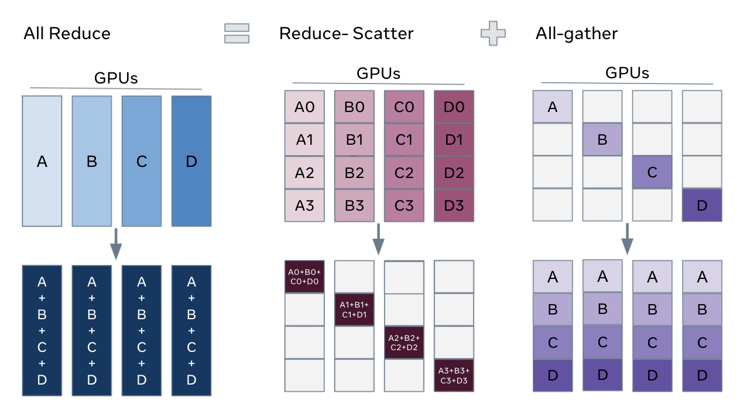
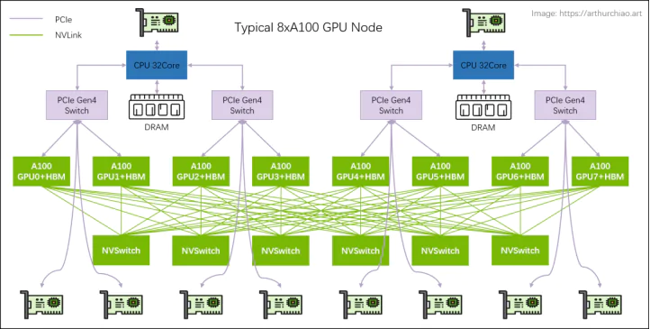
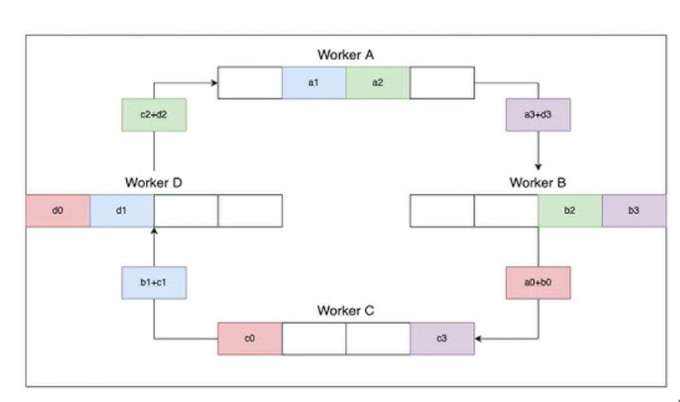
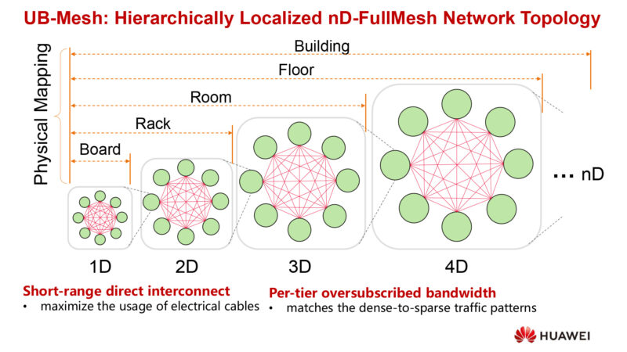
Implementations of collective communication op.s
All-reduce = Reduce-scatter + all-gather
The implementations
highly depends on
the hardware topology
NVIDIA GPU CLOS Topology
Ring All-reduce
HUAWEI NPU Full-mesh Topology
[1] https://docs.pytorch.org/tutorials/intermediate/FSDP_tutorial.html
[2] https://arxiv.org/abs/2304.11277
Notes:
单击此处添加文本

Slide 4
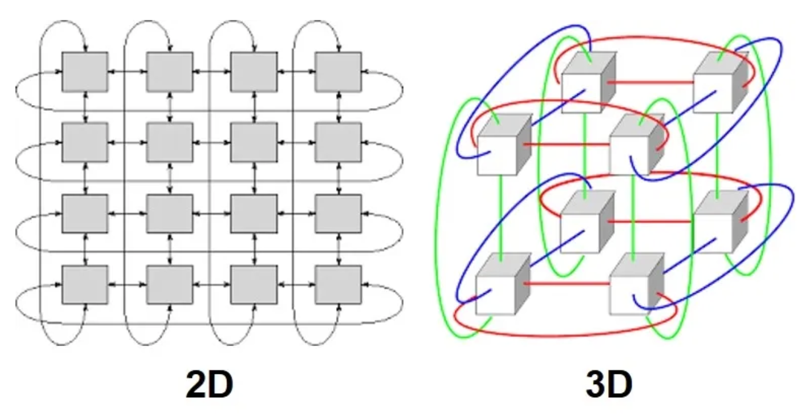
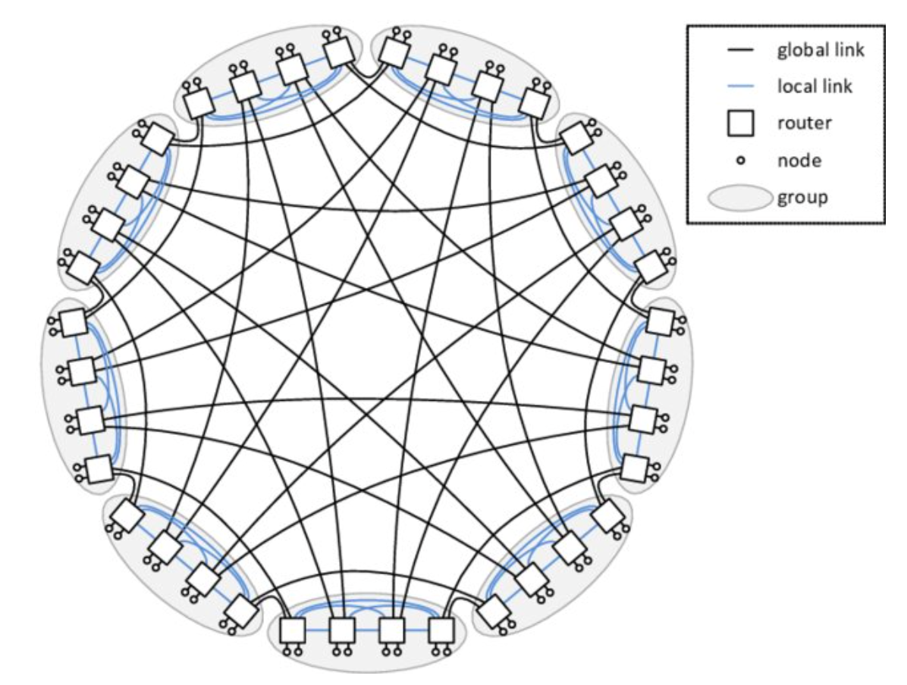
Topologies in the modern AI systems
NVIDIA GPU Clos Topology
GOOGLE TPU Torus Topology
HUAWEI NPU Full-mesh Topology
Dragonfly Topology
[1] https://ieeexplore.ieee.org/document/6337589/
Notes:
单击此处添加文本

Slide 5
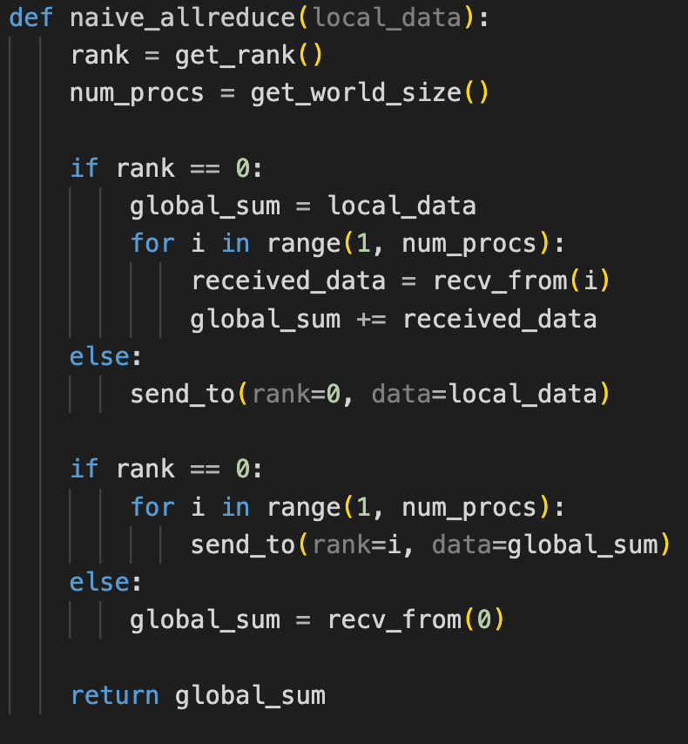
Take AllReduce as an example
Start from a naive implementation with root rank = 0.
Data transfer volume: 2 * (N-1) * K
There are three disadvantages
The bandwidth and computation of Rank 0 become bottleneck.
There are many idle resources during the allreduce (Rank 1 – N-1).
Poor scalability and lacks the consideration of topology.
How can we improve it?
Scatter the data transfer and computation workload to all of the ranks.
Solutions:
Tree-based, ring-based, halving-doubling, etc.
Notes:
单击此处添加文本

Slide 6
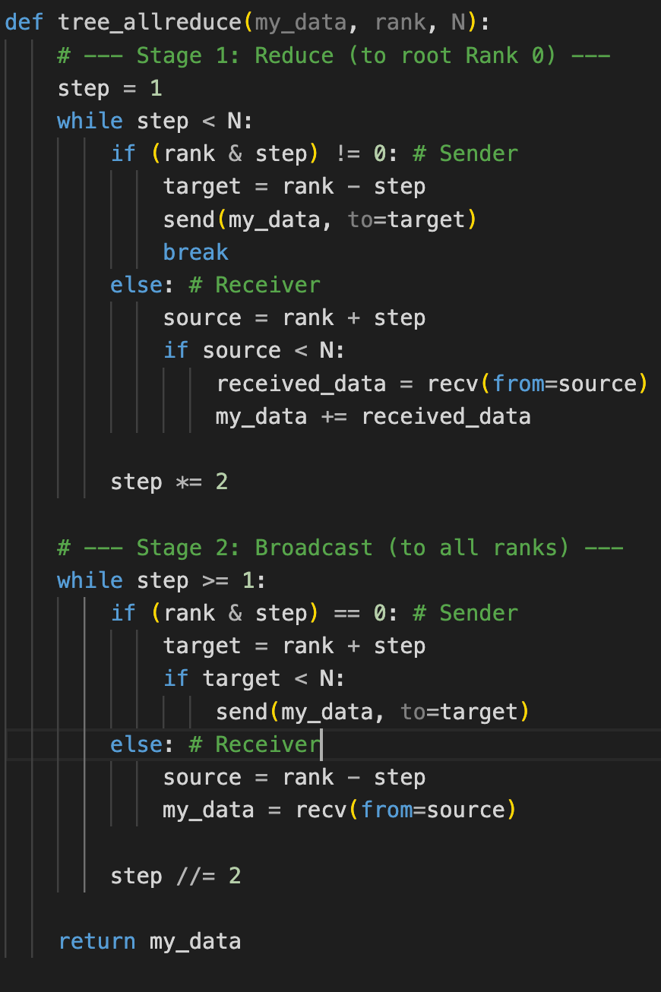
Take AllReduce as an example
Tree-based AllReduce Algorithm
Build a hierarchical relation with the root of tree (Rank 0).
Stage 1: Bottom-up Reduce
Stage 2: Top-down Broadcast
Rank 0
Rank 7
0
1
2
3
4
5
6
7
0+1
1
2+3
3
4+5
5
6+7
7
S1 Reduce
0+1+2+3
1
2+3
3
4+5+6+7
5
6+7
7
SUM(0,7)
1
2+3
3
4+5+6+7
5
6+7
7
Notes:
单击此处添加文本

Slide 7
Take AllReduce as an example
Tree-based AllReduce Algorithm
Build a hierarchical relation with the root of tree (Rank 0).
Stage 1: Bottom-up Reduce
Stage 2: Top-down Broadcast
Rank 0
Rank 7
SUM(0,7)
1
2
3
4
5
6
7
SUM(0,7)
1
2
3
SUM(0,7)
5
6
7
S2 Broadcast
SUM(0,7)
1
SUM(0,7)
3
SUM(0,7)
5
SUM(0,7)
7
SUM(0,7)
SUM(0,7)
SUM(0,7)
SUM(0,7)
SUM(0,7)
SUM(0,7)
SUM(0,7)
SUM(0,7)
Notes:
单击此处添加文本

Slide 8
Take AllReduce as an example
Tree-based AllReduce Algorithm
Build a hierarchical relation with the root of tree (Rank 0).
Stage 1: Bottom-up Reduce
Stage 2: Top-down Broadcast
Advantages
Parallel data transfer and reduce operations.
Logarithmic complexity (the naive version has linear complexity).
It excels with small data sizes because of the low latency.
Disadvantages
It still has idle computing and bandwidth resources.
Further Opt: Double Binary Tree (NCCL)
Notes:
单击此处添加文本

Slide 9
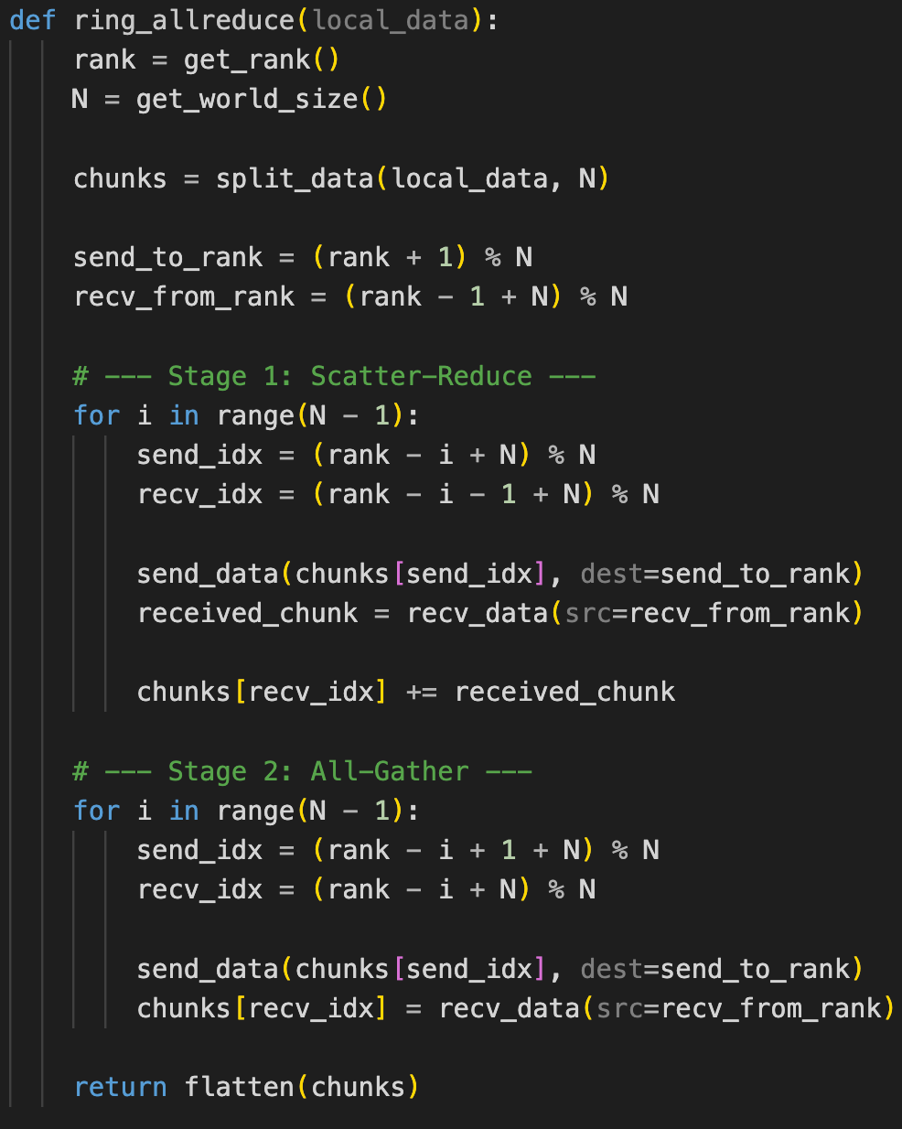
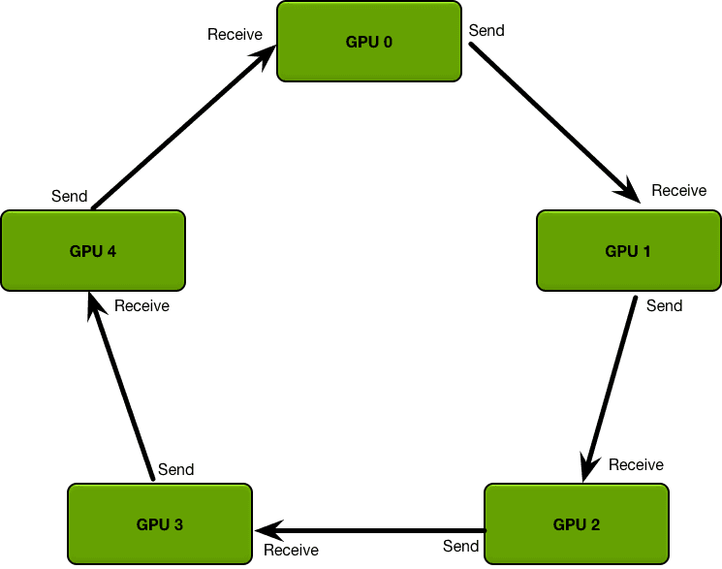
Take AllReduce as an example
Ring-based AllReduce Algorithm
Stage 1: Iterative Reduce
Stage 2: Iterative Gather
Notes:
单击此处添加文本

Slide 10
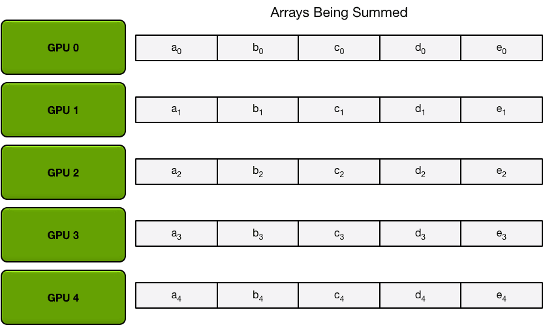
Take AllReduce as an example
Ring-based AllReduce Algorithm
Stage 1: Iterative Reduce with N-1 steps
Stage 2: Iterative Gather with N-1 steps
Split the data with N partitions
Notes:
单击此处添加文本

Slide 11
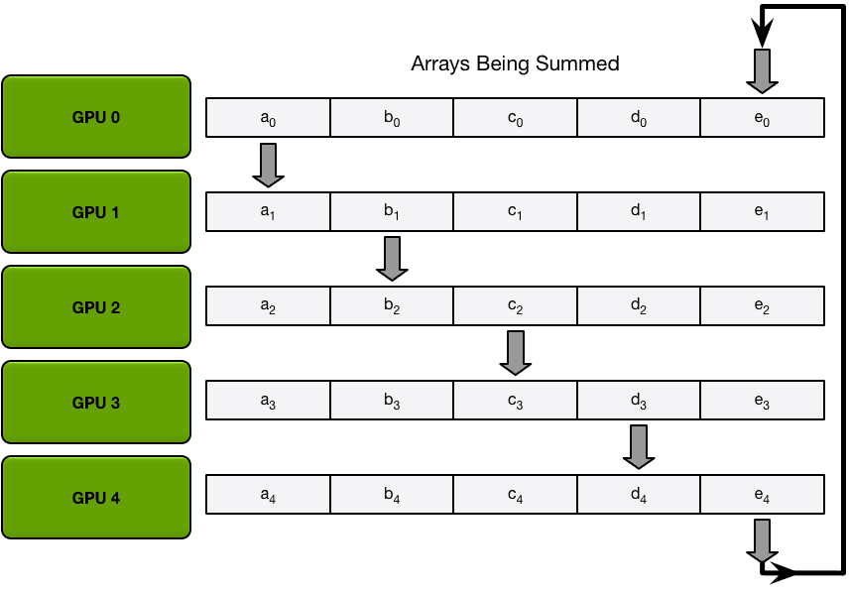
Take AllReduce as an example
Ring-based AllReduce Algorithm
Stage 1: Iterative Reduce with N-1 steps
Stage 2: Iterative Gather with N-1 steps
Notes:
单击此处添加文本

Slide 12
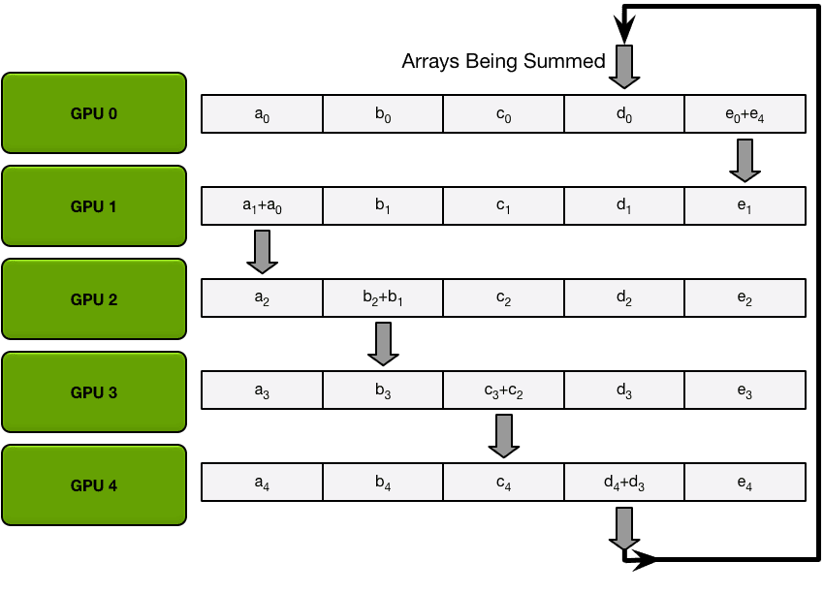
Take AllReduce as an example
Ring-based AllReduce Algorithm
Stage 1: Iterative Reduce with N-1 steps
Stage 2: Iterative Gather with N-1 steps
Notes:
单击此处添加文本

Slide 13
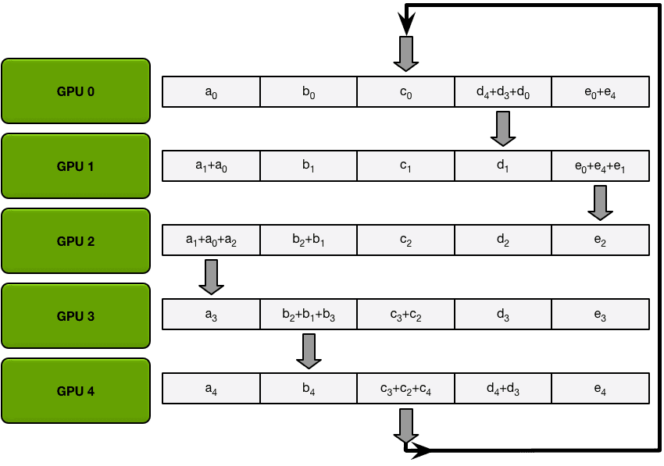
Take AllReduce as an example
Ring-based AllReduce Algorithm
Stage 1: Iterative Reduce with N-1 steps
Stage 2: Iterative Gather with N-1 steps
Notes:
单击此处添加文本

Slide 14
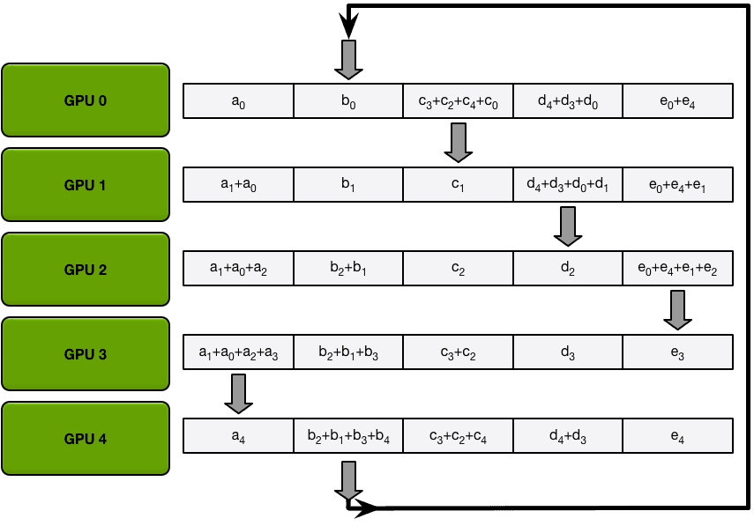
Take AllReduce as an example
Ring-based AllReduce Algorithm
Stage 1: Iterative Reduce with N-1 steps
Stage 2: Iterative Gather with N-1 steps
Notes:
单击此处添加文本

Slide 15
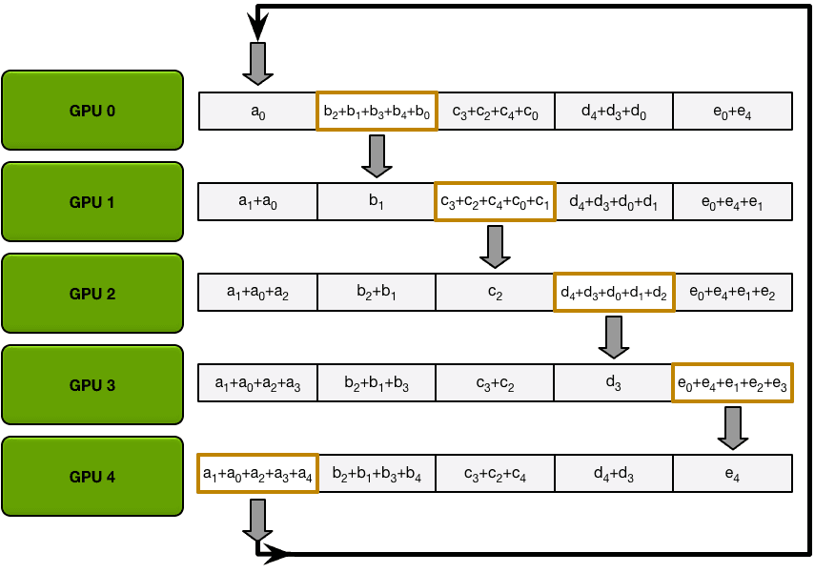
Take AllReduce as an example
Ring-based AllReduce Algorithm
Stage 1: Iterative Reduce with N-1 steps
Stage 2: Iterative Gather with N-1 steps
Notes:
单击此处添加文本

Slide 16
Take AllReduce as an example
Ring-based AllReduce Algorithm
Stage 1: Iterative Reduce with N-1 steps
Stage 2: Iterative Gather with N-1 steps
Quantitative Analysis
Data Transfer Volume: 2 * (N-1) * K / N
Overall Time: 2 * (N-1) * alpha + 2 * (N-1) * K / N / beta
Tree-based AllReduce Time : 2 * log(N) * (alpha + K / beta)
alpha: latency; beta: bandwidth
Advantages: Optimal bandwidth utilization
Notes:
单击此处添加文本

Slide 17
Take AllReduce as an example
Ring-based AllReduce Algorithm
Stage 1: Iterative Reduce with N-1 steps
Stage 2: Iterative Gather with N-1 steps
Quantitative Analysis
Data Transfer Volume: 2 * (N-1) * K / N
Overall Time: 2 * (N-1) * alpha + 2 * (N-1) * K / N / beta
Tree-based AllReduce Time : 2 * log(N) * (alpha + K / beta)
alpha: latency; beta: bandwidth
Advantages: Optimal bandwidth utilization
Notes:
单击此处添加文本

Slide 18
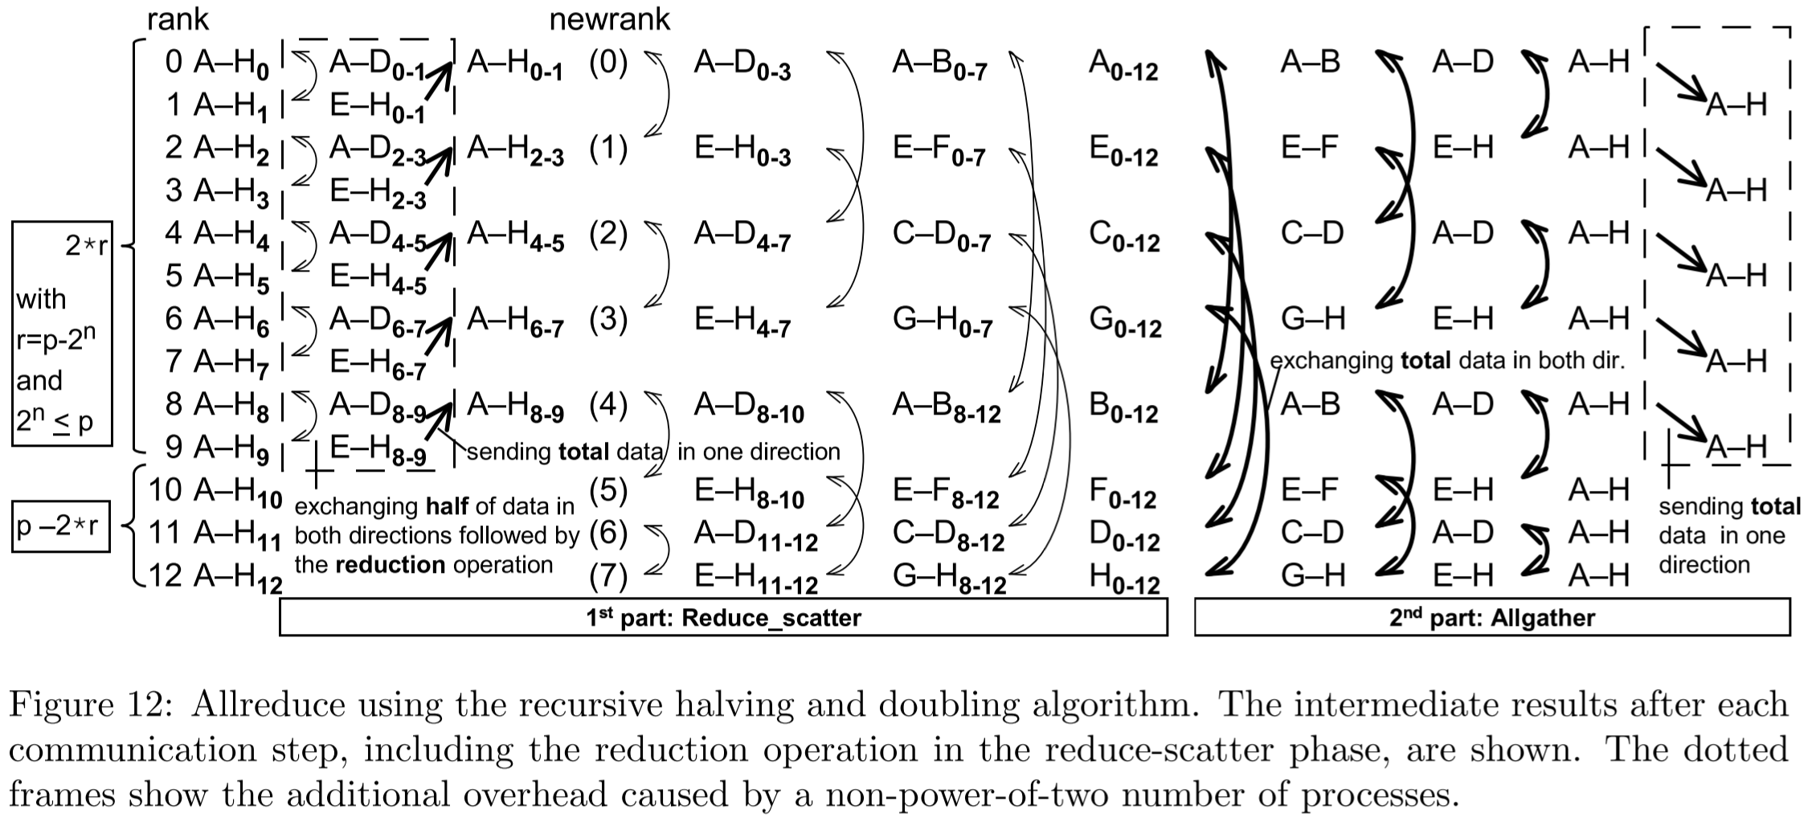
Take AllReduce as an example
Halving-doubling AllReduce Algorithm
Stage 1: Recursive halving reduce
Stage 2: Recursive doubling gather
[1] https://www.semanticscholar.org/paper/Optimization-of-Collective-Reduction-Operations-Rabenseifner/e2584fdc3f9e696423d96522038f3fa35137ab92
Notes:
单击此处添加文本

Slide 19
Take AllReduce as an example
Comparisons among ring-based, tree-based, and halving-doubling Allreduce algorithms.
Modern CCLs can select an efficient strategy according to the topology and the communication domain.
Algorithm | Steps (Complexity) | Latency | Bandwidth Efficiency | Ideal Data Size
Ring-based | O(N) | High | Optimal | Large Data (> 64MB)
Tree-based | O(log N) | Lowest | Moderate | Small-Medium (< 16MB)
Halving-Doubling | O(log N) | Low | Moderate | Very Small (< 1MB)
Notes:
https://zhuanlan.zhihu.com/p/1976385706453652306

Slide 20
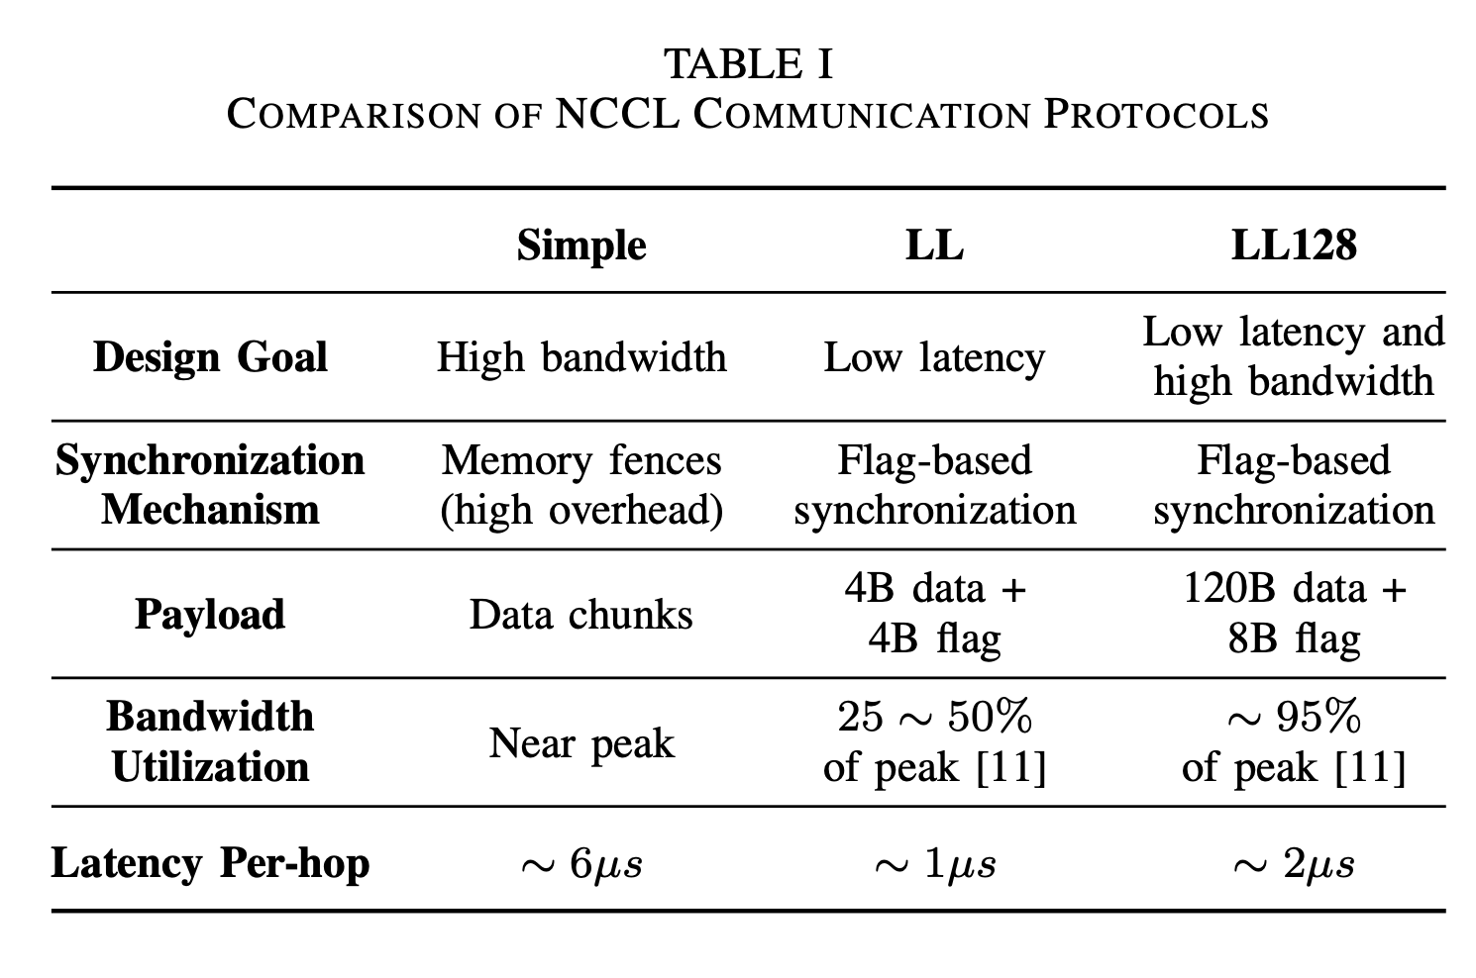
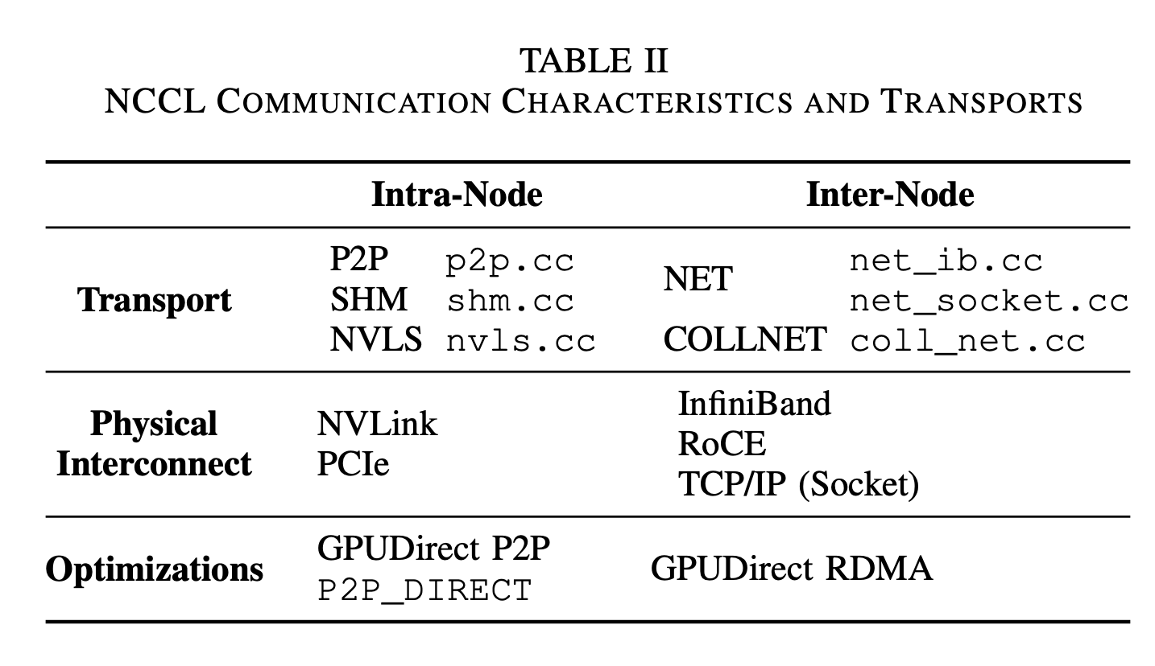
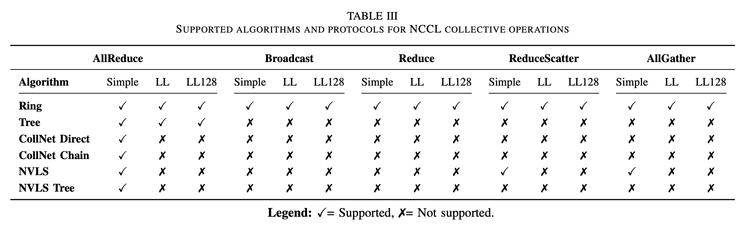
Besides, the protocol designs are also important
Take NCCL as an example.
[1] https://arxiv.org/pdf/2507.04786v1
Notes:
单击此处添加文本

Slide 21
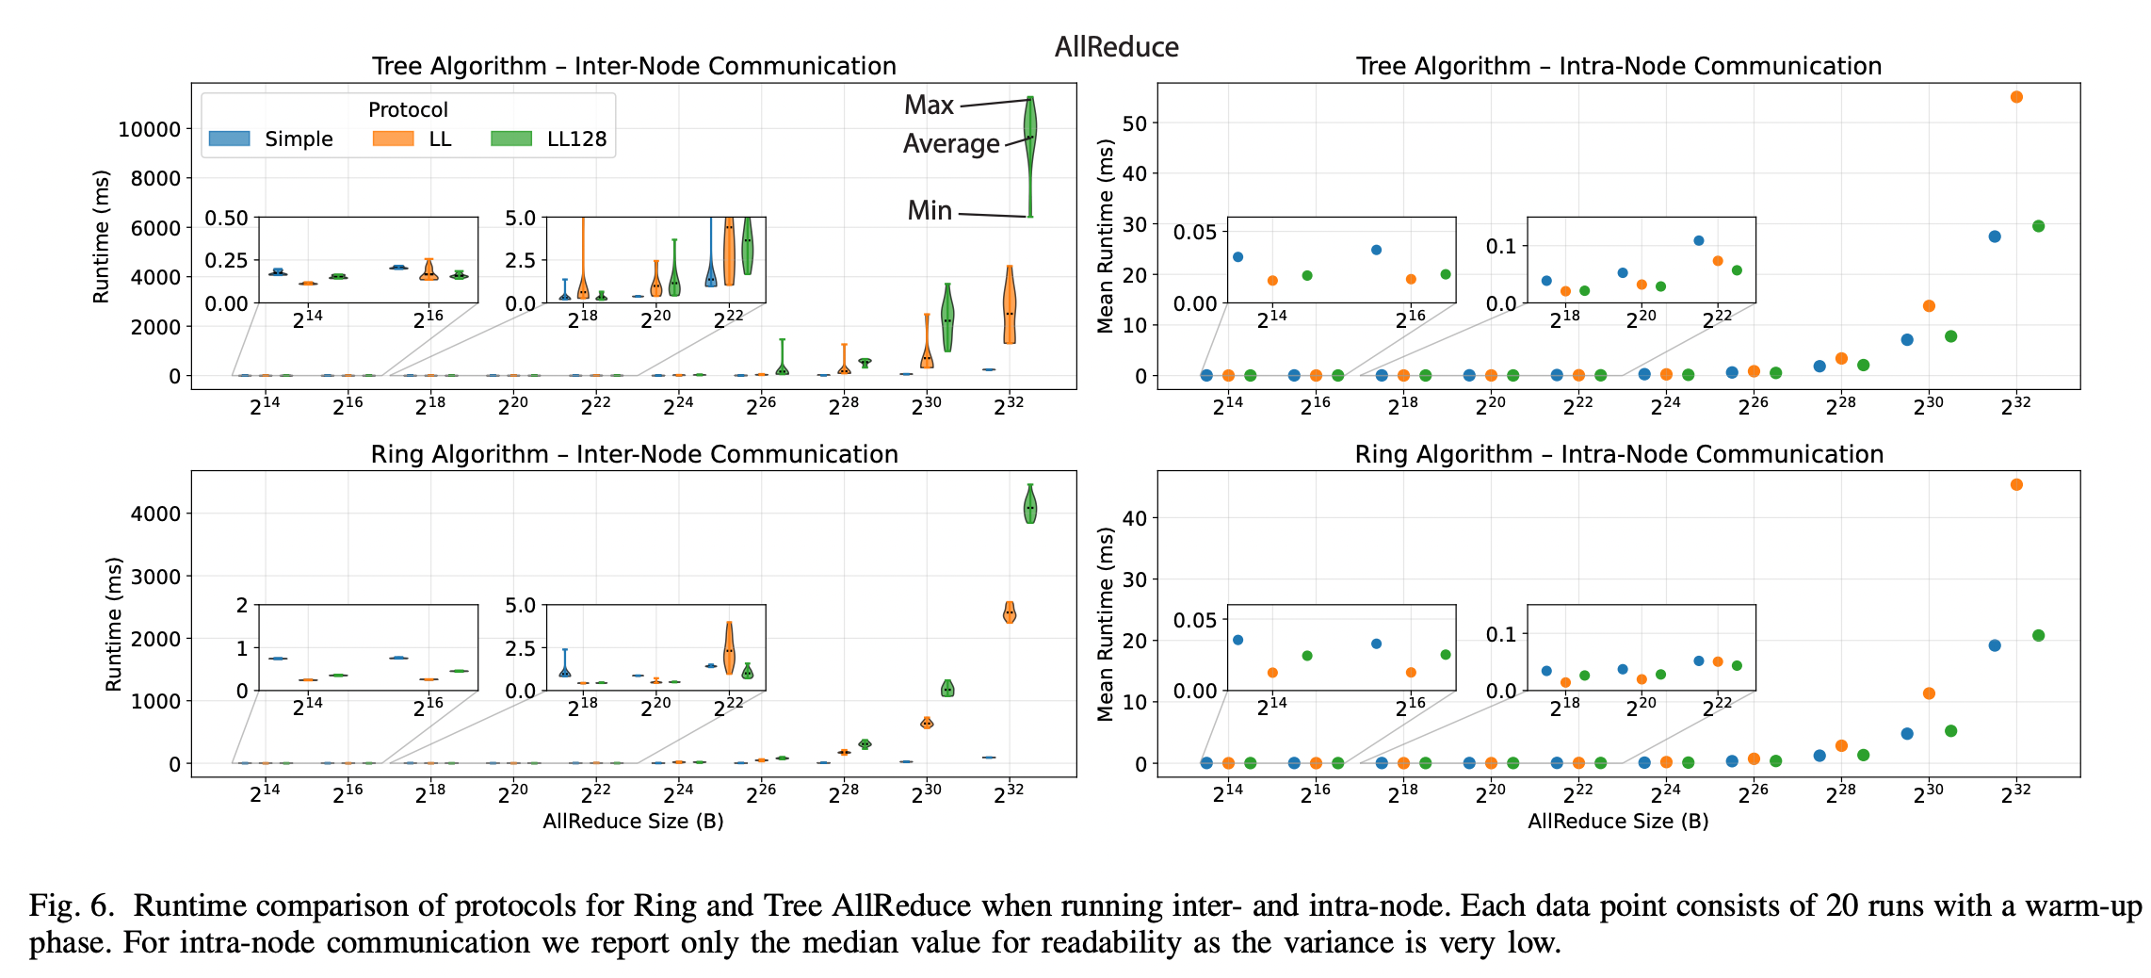
Besides, the protocol designs are also important
Take NCCL as an example.
[1] https://arxiv.org/pdf/2507.04786v1
Notes:
https://zhuanlan.zhihu.com/p/1976385706453652306

Slide 22

The Solution: FlagOS, a Unified AI Software Stack

Slide 23








https://space.bilibili.com/3546791834290849
https://github.com/flagos-ai
https://www.zhihu.com/people/95-22-20-18/posts
https://flagos.io/Home

Slide 24

Thanks for your time！

